Slide 1

CUDA For Engineers
Saif Ul Islam – Undergrad, FAST NUCES @ Karachi

Slide 2
Introduction To Myself
I'm Saif! I'm currently an undergrad from FAST NUCES, Karachi, majoring in Computer Science.
Interested in,
- Web Dev, Data Engineering, HPC, Software Engineering, Backend Architecture and Infrastructure Design
What's my experience with CUDA?
Not on many social media, but you can connect with me on,
- Github, https://github.com/rubix982
- LinkedIn, https://www.linkedin.com/in/saif-ul-islam-93786b187/
- Stack Overflow, https://stackoverflow.com/users/10576072/saif-ul-islam
- Mail, saifulislam84210@gmail.com

Slide 3
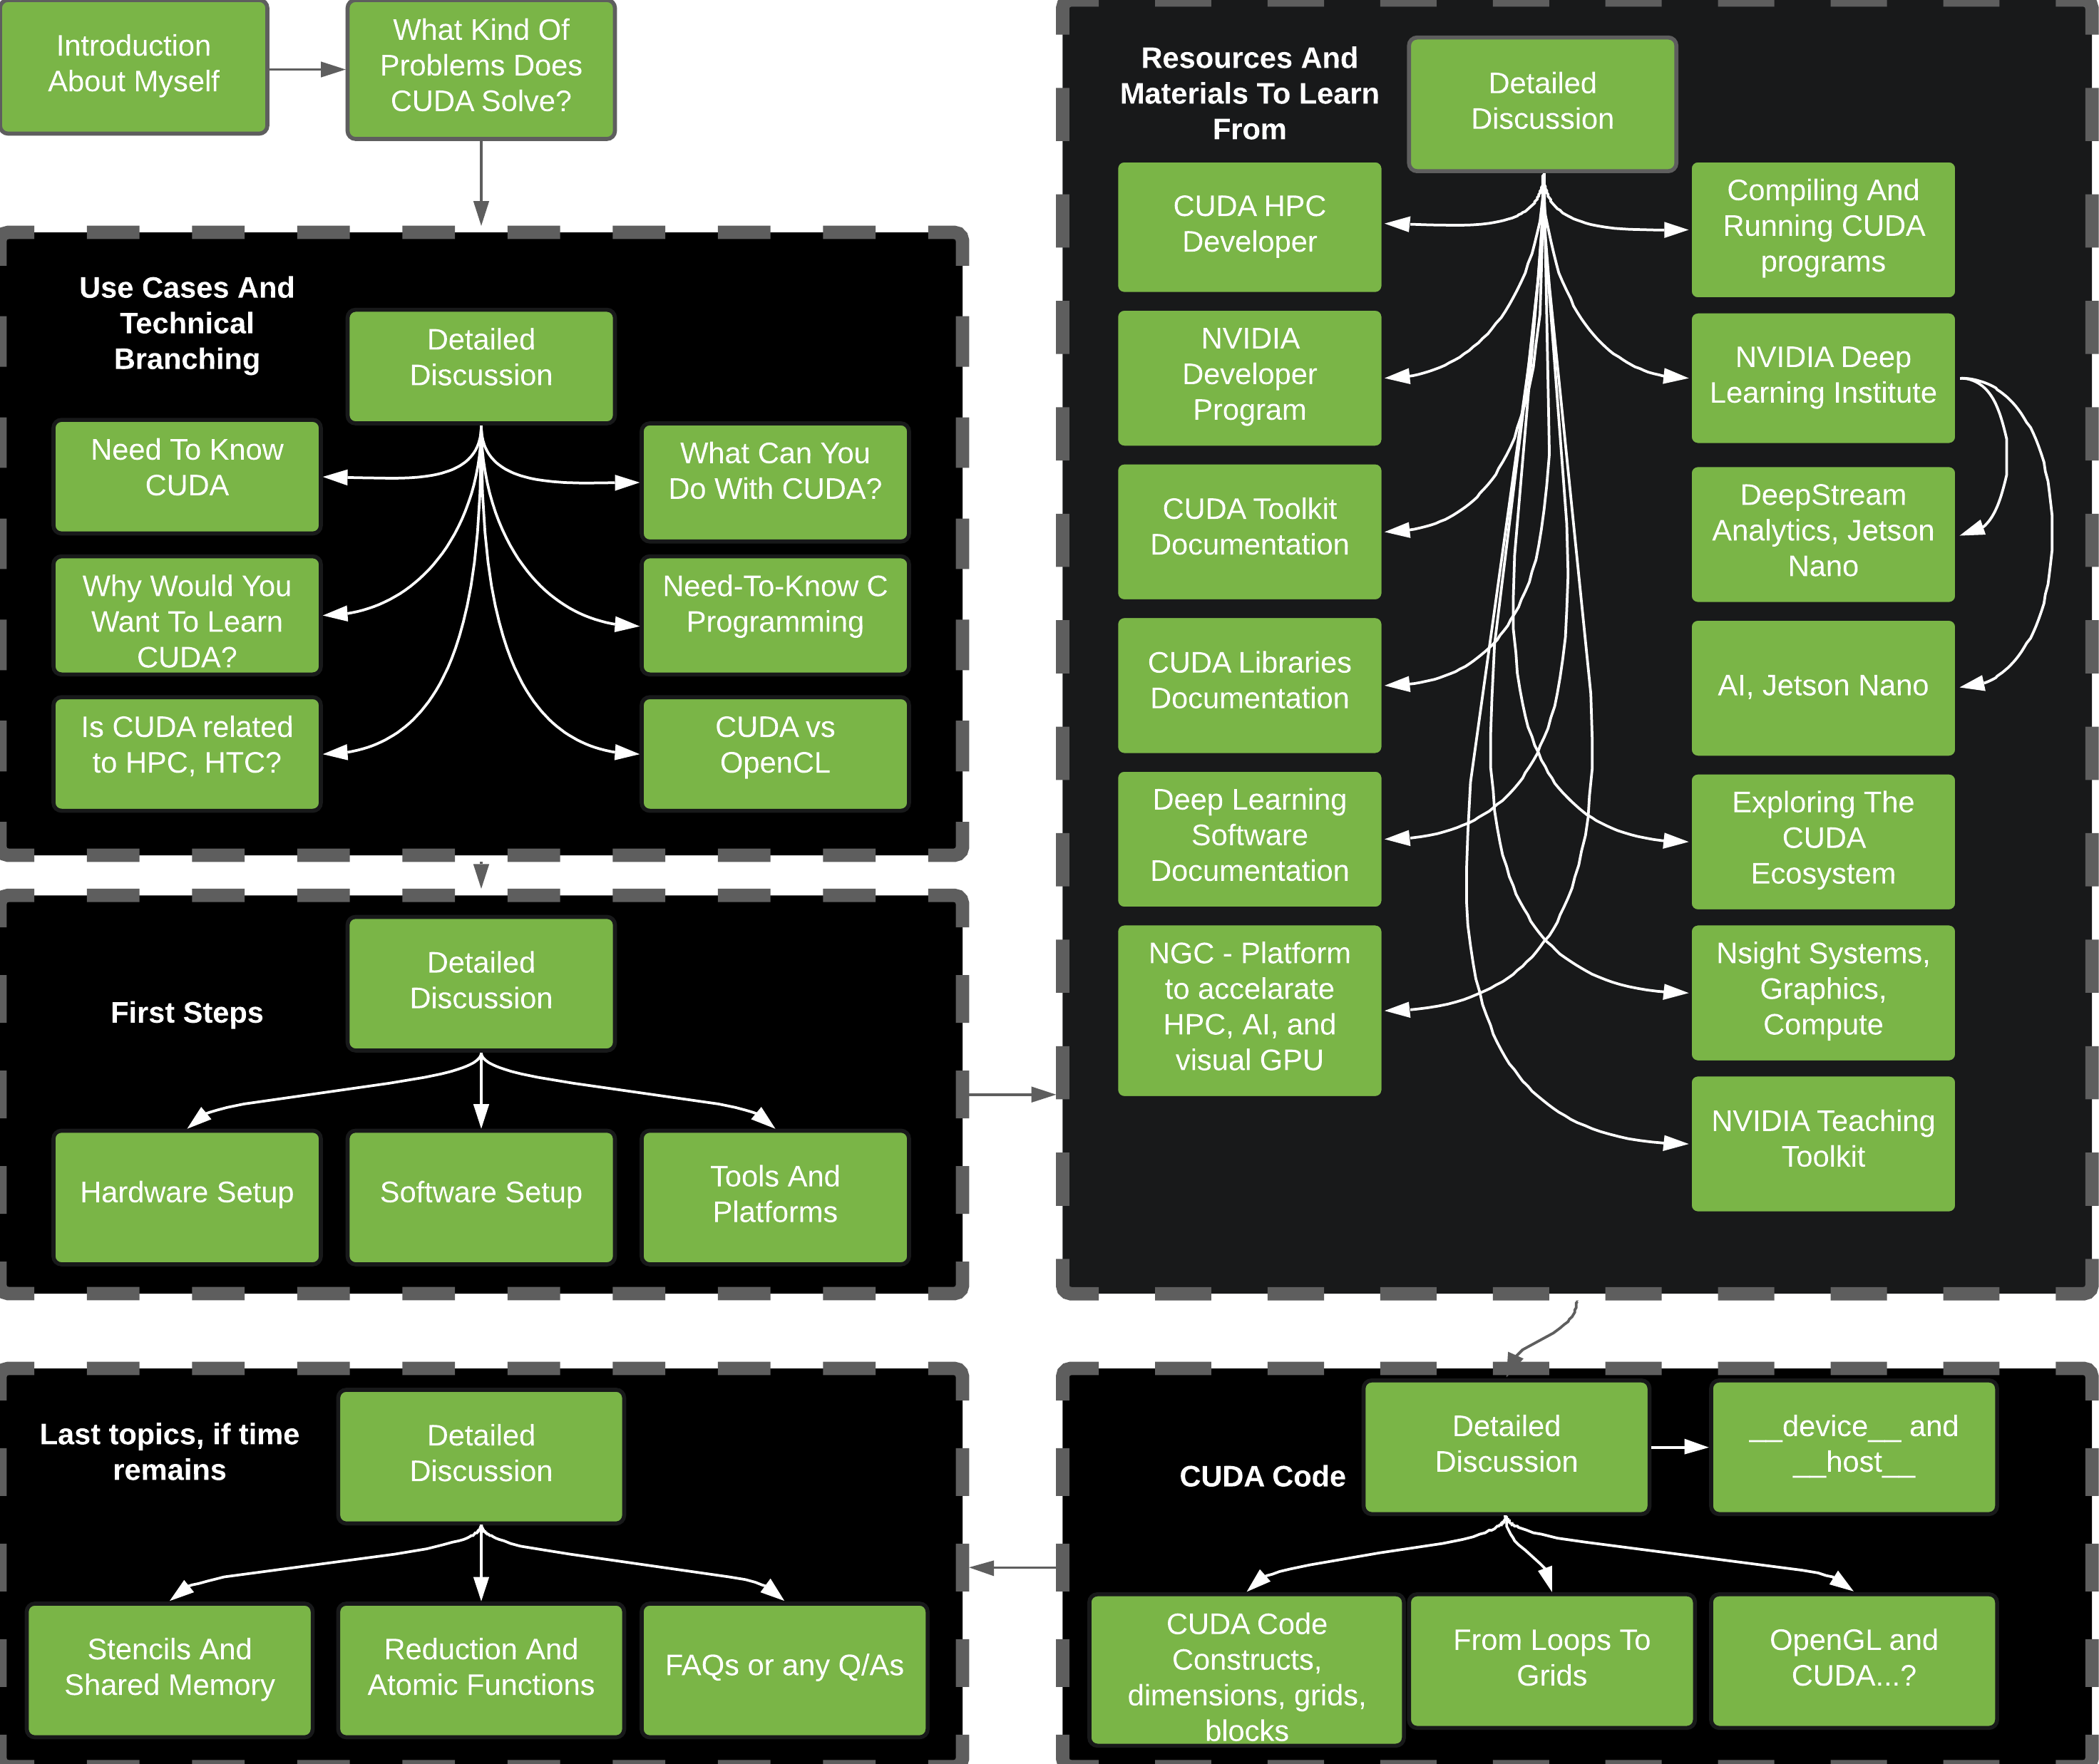
Table Of Contents

Slide 4
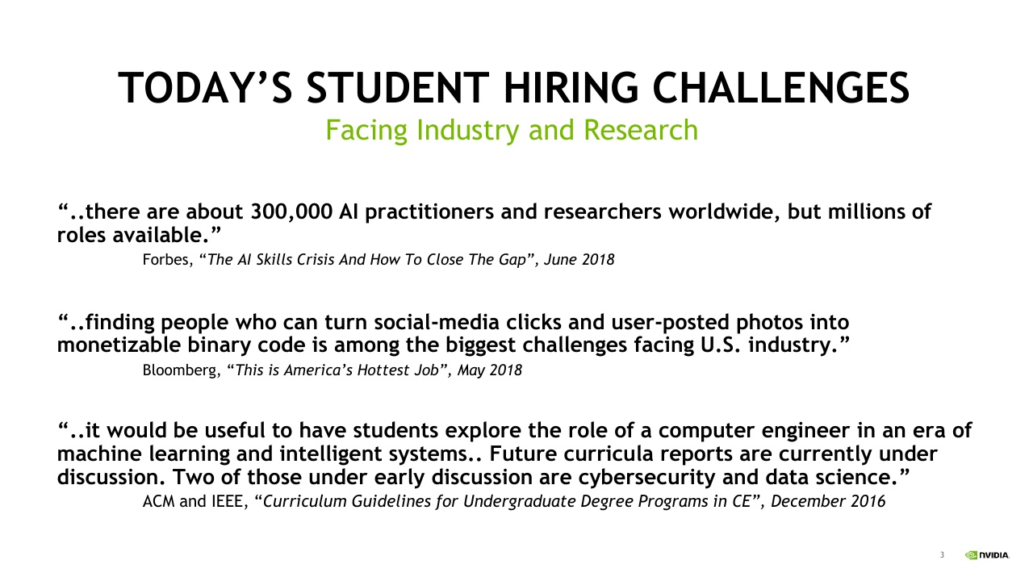

Slide 5
What Kind Of Problems Does CUDA Solve?
- SIMD Architecture
- Massively Parallel
- Designed to run as an abstraction for different GPU hardware
- Easy to compile and run, provides compilers a target instruction level code, like Assembly
- Contains well maintained libraries, profiling tools, industrial grade technologies

Slide 6
Use Cases And Technical Branching
Use Cases

Slide 7
Why Would You Want To Learn CUDA?
Growing HPC trends, coming 5-10 years
Easy way to access, explore what HPC is about
Needed engineers, required expertise with optimizing operations
Growing hardware, software level scale for high portability, efficient code and databases.
Edge networking devices, along with IoT trends
Graphs galore!

Slide 8
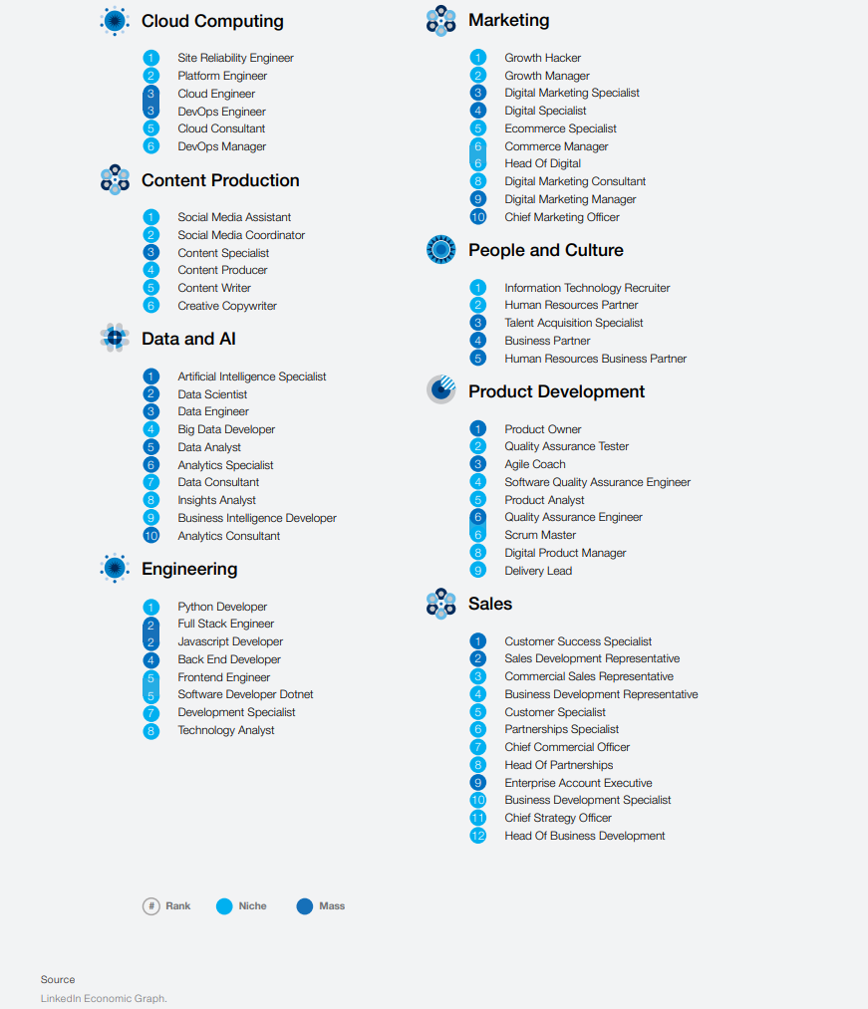

Slide 9
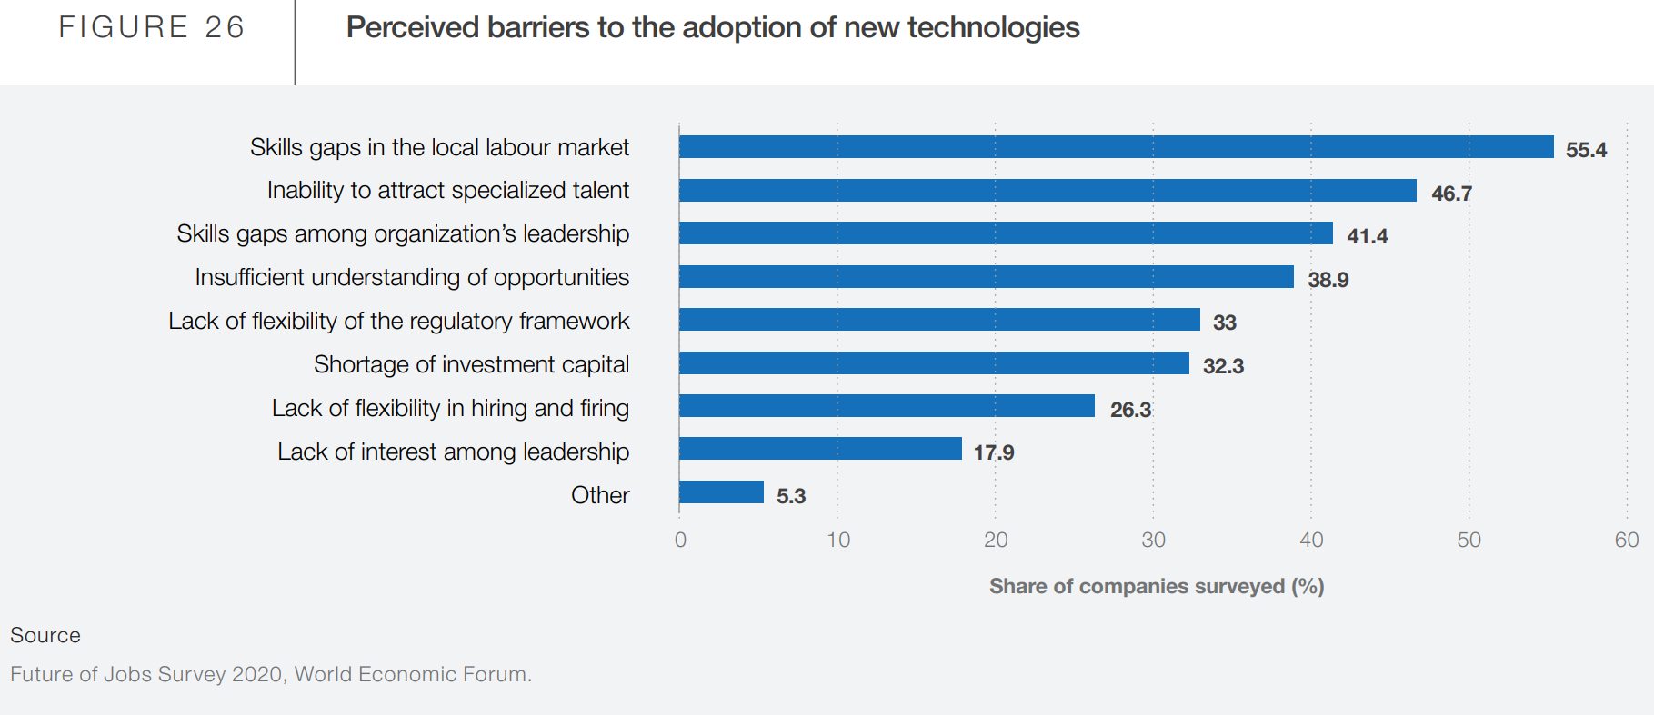

Slide 10
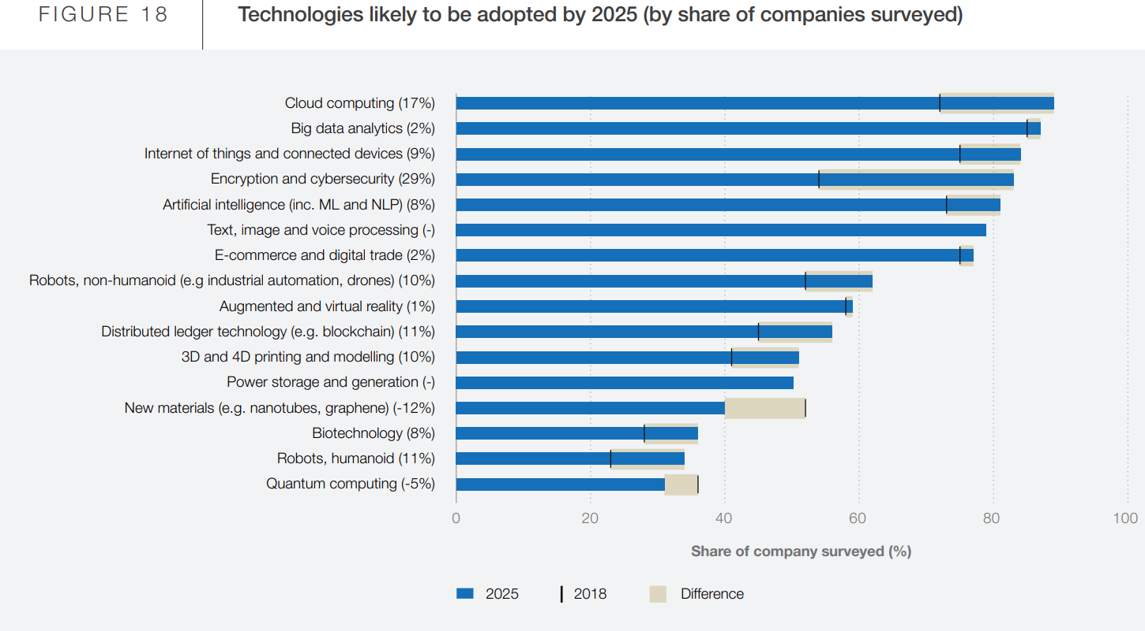

Slide 11
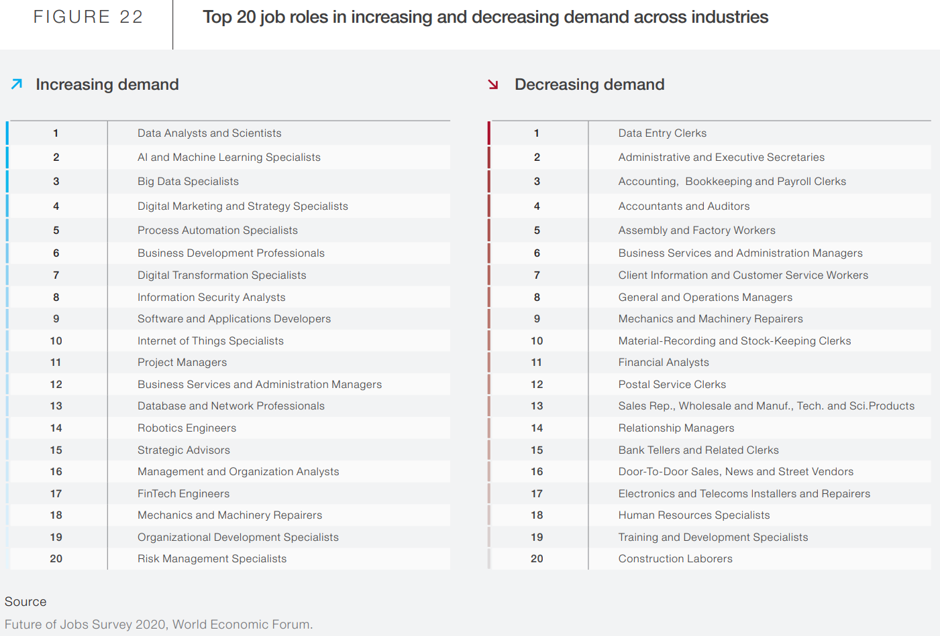

Slide 12
Read the whole report here! "The Future of Jobs Report 2020 October 2020"

Slide 13
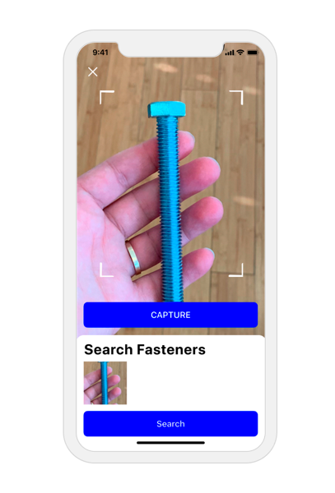
What Can You Do With CUDA?
Easily massive parallel algorithms
Research worthy platforms, for Fortran, Matlab, C++
Deep learning, IoT as naive examples
Brytlyt! - A complete SQL GPU solution for RDBMS
Pilot.Ai - Retail Analytics, Jetpack | Jetson Tx2 | RTX 2080, video demo is here
Interspectral - Education, Industry, Science & Comm | vGPUS | Education Demo
Kognat - CUDA accelerated AI rotoscoping | Demo
Slyce - Real time scan item | Jetpack
Keyshot – 3D Graphics Generation | Marketing | VR | AR | NVIDIA OptiX Denoiser | Demo
All thanks to NVIDIA! Dozens of more examples are here

Slide 14
The "Need To Know CUDA" Term
Simply because CUDA is one of the easiest ways right now, best-supported, compatible, portable, and the most accessible platform for using the power of GPUs
Getting a basic understanding of how CUDA works sets you on the way to create good to greater CUDA applications
Reduces time to market for technology that simply need speedup. Often when an algorithm cannot be further optimized, it might be worth it to look at the GPU section for optimizing your applications
Fundamental to basic APIs and libraries that already take care of the low level GPU part, compatible with modern code and design philosophies

Slide 15
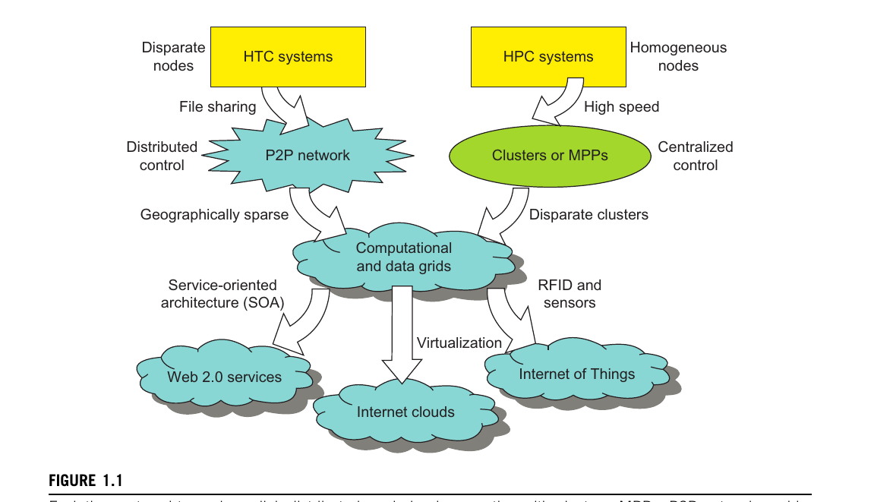
CUDA And HPC, or HTC?
CUDA mostly deals with HPC, "Distributed And Cloud Computing … "

Slide 16
CUDA Vs OpenCL
NVIDIA GPUs use CUDA as an abstraction layer, for the compiler to target as for the respective assembly and architecture
AMD primarily looks at using OpenCL, Open Computing Language, for its GPUs
OpenCL by itself provides an abstraction layer between the hardware and software for GPUs.
It's an 'interface', a standard, for providing low level instructions to CPUs, GPUs ( of any vendor, even NVIDIA )
CUDA is specifically designed for NVIDIA GPUs
Writing OpenCL is considered more low level as compared to NVIDIA
A tradeoff in development to promote cross compatibility

Slide 17
Need To Know C Programming
To begin, you do not need to already be a Computer Scientist, or an Experienced Programmer ( though it helps )
You do not need to be very technical to get started with CUDA – a basic intuition and idea is enough
Basics of C programming and a CUDA capable NVIDIA GPU are enough,
Variables, functions, loops, header file #includes, assignments, operators, compiling, running, and debugging code, control statements, arrays, memory allocation and deallocation
Preferred IDE is Visual Studio, if Windows
Makefiles are mostly enough when working in Linux
NVVP, NVIDIA Visual Profiler, a profiling tool that comes with CUDA Toolkit
cuda-gdb, a command line debugger for CUDA programs
General standard is to have source files be indicated by *.cu extension, header files be indicated by *.cuh extension

Slide 18
Break! Currently summary for discussed topics. Any Q/A?

Slide 19
First Steps

Slide 20
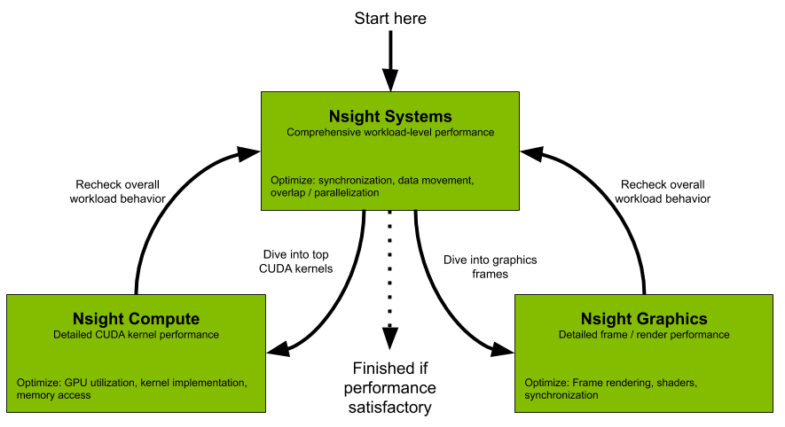
Tools And Platforms
Windows
Linux
MacOS

Slide 21
Hardware Setup
Windows
Linux
MacOSX
Determining Compute Capibility
Detailed notes for hardware setup are here

Slide 22
Software Setup - Windows
Make sure to sign up for the "CUDA Zone" for a full list of CUDA-Dev related material
Create a restore point ( recommended ) by going to 'Control Panel' -> Type 'Create a restore point' in the search box. Click on search result to open 'System Protection' tab in 'System Properties' tab. To create a restore point, click on 'Create...'. I maybe wrong, so please check this out
Recommended IDE and setup are Visual Studio 2019, CUDA Toolkit 11.2, and Nsight Visual Studio Edition 2020.3.0. These versions are the latest at the time of writing. Please make sure to ensure compability between these. Downgrad as needed.
The CUDA Toolkit should take care of 4 primary software components, CUDA Toolkit itself, CUDA GPU Device Driver, NSight Visual Studio Edition, and CUDA Samples.
After installation, go ahead and open one of the cuda samples under 'All Programs', choose any of the given examples, open up a .vsproj file, that should open up a project. Press the F7 key to start the build process. Executables are generated within the bin folder, then double click to execute it
For the complete documentation, read the documentation article

Slide 23
Software Setup - Linux
Make sure to sign up for the "CUDA Zone" for a full list of CUDA-Dev related material
Make sure to verify that you indeed have a CUDA capable GPU from the 'Hardware Setup' section
Check to make sure you have the gcc compiler, by running 'gcc –version'. If not, simply run 'sudo apt-get install gcc'
Get the CUDA Toolkit 11.2. If on [Lu,Xu,U,Ku]buntu, double click on the download file, it should open the Software Center. When complete, run the following in a terminal, 'sudo apt-get update –y; sudo apt-get install cuda'.
Open with a text editor, profile configuration at '~/.profile', append 'export PATH=/usr/local/cuda/bin:$PATH', save and exit. Now, similarly open '~/.bashrc', append 'export LD_LIBRARY_PATH=/usr/local/cuda/lib64:$LD_LIBRARY_path', save and exit
Restart the machine, via a terminal, run 'printenv | grep cuda'. If you get lines with a results that 'cuda' in them, the setup was successful. Also, you can now run the cuda compiler, called NVIDIA C Compiler', by running 'nvcc –version'
To generate cuda samples, run 'cuda-install-samples-7.5.sh ~'. This generates the samples as '~/NVIDIA_CUDA-7.5_Samples'. Run 'ls ~/NVIDIA_CUDA-7.5_Samples'. To see those samples.
To run a sample, visit any of the samples, run 'make' in the same directory as a makefile. This generates an executable binary, for example 'exectuble', then run './executable'.
For the complete documentation, visit this documentation article

Slide 24
Software Setup - MacOS
Make sure to sign up for the "CUDA Zone" for a full list of CUDA-Dev related material
To be able to setup CUDA, you need to have a CUDA enabled GPU. MacOS mostly does not have 3rd party hardware updates, so you might need to consider getting a platform release that does have something like that.
NVIDIA has officially cut off working and building for MacOS. The latest version for MacOS at the moment is 10.2, compared to the latest for Windows / Linux, which is 11.2. You can read the full article here, https://www.provideocoalition.com/officially-official-nvidia-drops-cuda-support-for-macos/
To people who still are interested, check out https://www.nvidia.com/en-us/drivers/cuda/418_163/macosx-cuda-418_163-driver/, for until MacOS 10.13.

Slide 25
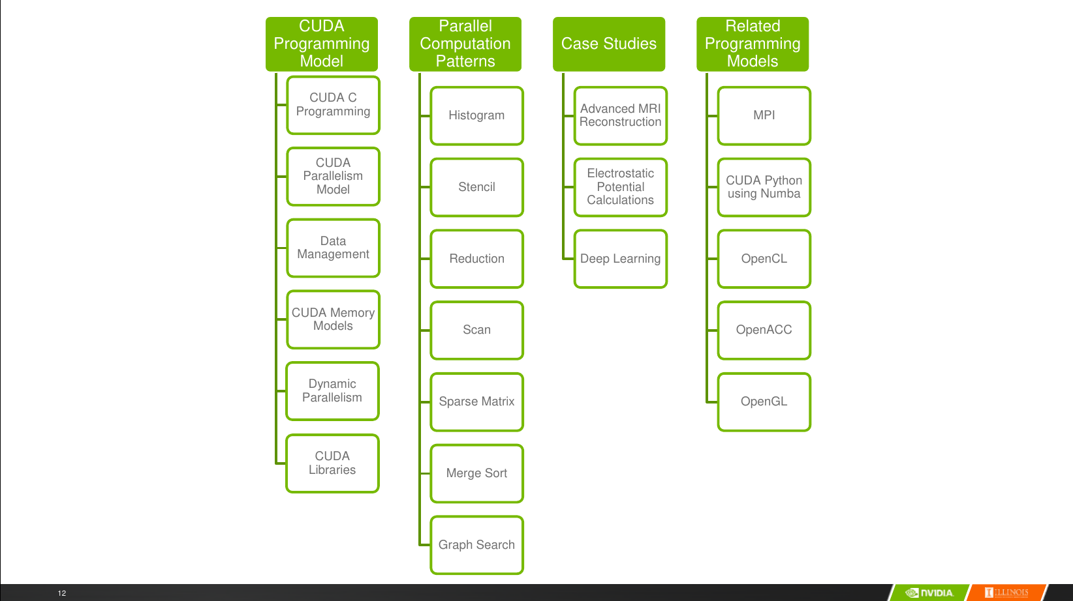

Slide 26
Break! Currently summary for discussed topics. Any Q/A?

Slide 27
Resources, And Materials To Learn From
The section dedicated to expanding and looking into the CUDA, NVIDIA ecosystem

Slide 28
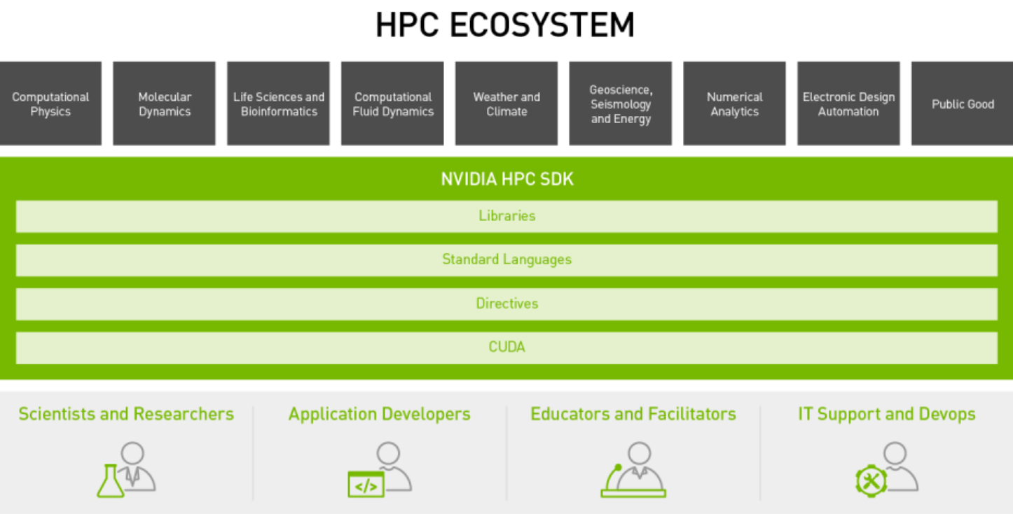
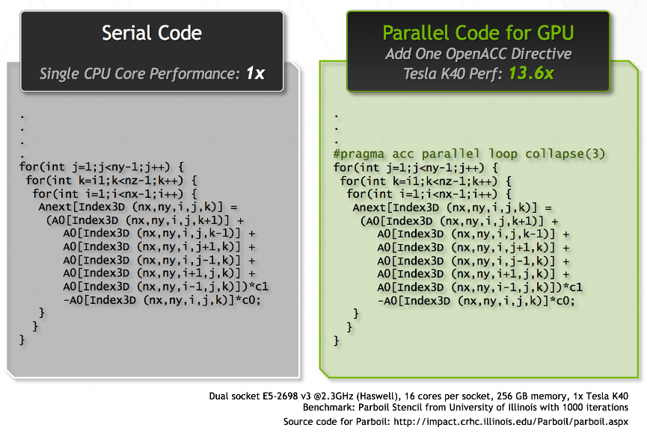
CUDA HPC Developer
The CUDA HPC Developer program consists of smaller sub programs,
"GPU Programming for HPC.", which includes libraries for math, image and video algorithms, deep learning, partner libraries etc, standardized C/C++/Fortran/MATLAB support, OpenACC development, as shown on the right. Visit here for more details.
"NVIDIA HPC SDK", contains extensive details for, also shown in the right slide, Scientists, Application Developers, Educators, and IT Support / DevOps. You can visit it here
"Exploring Technical Content", has on-demand sessions, podcasts, demos, research posters. Please visit this extensive search option for an in depth category and filtering option, or here if you would just like a high overview analysis

Slide 29
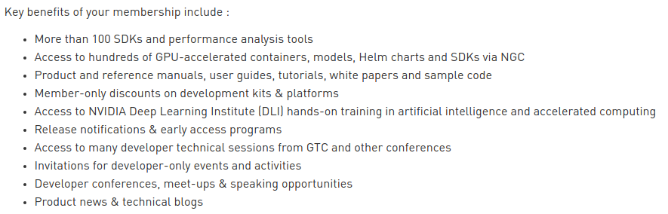
NVIDIA Developer Program
Joining the developer program gives you tons of benefits right of the bat for your project
Easy access to CUDA Libraries
… And tons of material, for free
You can check out this link

Slide 30
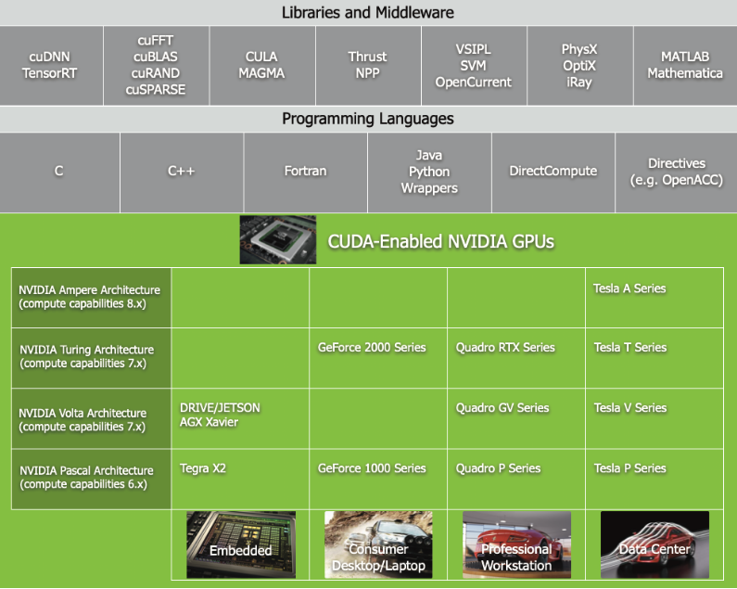
CUDA Toolkit Documentation
As with everything, there is a documentation and guide for everything CUDA related and its libraries.
It's pretty huge, and is meant as a developer guide
Use it only when you need to

Slide 31
CUDA Libraries Documentation
Linear Algebra, Differential Equations, Sparse and Dense Matrixes, Matrix Factorizations, Random Number Generators, , Video Filtering and Segmentation, and so much more
There's cuBLAS, cuSOLVER, NPP ( NVIDIA Performance Primitives ), cuTENSOR, nvJPEG, etc
You can check out the complete list here

Slide 32
NGC – Platform To Accelerate HPC, AI, and Visual GPU
Serves as a main repository for whatever content NVIDIA may release related to IT Support / DevOps or for Application Developers.
Sorts the tools available in NVIDIA according to 'Industry', 'AI Application', and 'Technology'
There are categories to explore in, 'Collections', 'Containers', 'Helm Charts', 'Models', 'Resources'
Main focus on GPU optimized developer solutions, for DL, ML, and HPC, and their rapid deployment
If you have any questions or run into any problems, there is always the NVIDIA Forums

Slide 33
NVIDIA Deep Learning Institute – 1/2
Mainly focused on the training side for people who might be interested in either,
Self-paced courses
Most courses are paid, except two very popular programs "Getting Started With AI On Jetson Nano", "Getting Started With DeepStream For Video Analytics On Jetson Nano" are free and available as self-paced.
Check out the course catalog here
Instructor-led workshops
Not completely avaible as free and viable options
Need to contact NVIDIA, who ask a certified Deep Learning Instructor to lead the workshop. If you're still interested, check out this link
Educator Programs and toolkits. Has resources for
Teaching Kits - Deep Learning, Accelerated Computing, and Robotics. Viable option for educators willing to teach these materials in their classrooms. Link is this.
University Ambassador Program - members receive course materials, instructor assessments, certification interviews to help you become a Deep Learning Instructor ( DLI ) certified, and deliver DLI courses. Find out more here
Jetson AI Ambassador Certification - Two main programs at the moment, Jetson AI Specialist, and Jetson AI Ambassador. Learn more here

Slide 34
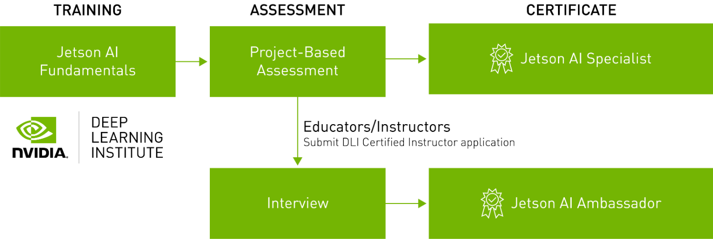
NVIDIA Deep Learning Institute – 2/2
Most of the people here wil most probably join a hardware or software oriented company. If you ever feel like your organization needs to incorporate enterprise level distributed high performance computing, NVIDIA has programs meant to help you configure your products with team oriented training. Visit here for more details

Slide 35
Deep Learning Software Documentation
There are specialized CUDA libraries related to just Deep Learning. The list deals with deep convolutional neural networks, tenors, the NVIDIA GPU training system, cloud interfacing solutions,
CuDNN - cuDNN is a "GPU-accelerated library of primitives for deep neural networks"
TensorRT - a "C++ library that facilitates high-performance inference on NVIDIA GPUs
NCCL - NCCL is a library "focused on accelerating collective communication primitives
DIGITS - DIGITS deals with training, monitoring, designing, managing, visualizing Deep Learning Tasks
NeMo - Art and speech related library
NVIDIA GPU Cloud – Cloud platform by NVIDIA for GPU-accelerated computing

Slide 36
Exploring The CUDA Ecosystem
Code samples are available at the end of the presentation
Exciting series of GTC keynotes. From Graphics Simulation, Retail, AI and Deep Learning, to Healthcare and HPC. See a complete catalogue here
ParallelForAll, a series of blogs related to NVIDIA CUDA and GPU computing. Start from here
Online courses
"Udacity CS344: Intro To Parallel Programming", as the description explains it, "This class is for developers, scientists, engineers, researchers, and students who want to learn about GPU programming, algorithms, and optimization techniques". It's free and available here
"Heterogenous Parallel Programming", deals with C/C++/OpenACC, contains introduction to both CUDA and OpenCL. Also free and available at this link
"Programming Massively Parallel Processors With CUDA", a set of recordings of a lecture at Stanford, offered in the Spring of 2010, by Dr. Jared Hoberock, and Dr. Nathan Bell. Available as free recordings on iTunes, here. A book with the same name can be found here.

Slide 37
NSight Systems, Graphics, Compute
Some basic tools, as discussed before.
NSight Systems - Performance Analysis Tools to make sure the workstation or servers are running at full capacity and are not at an 'idle' state
NSight Graphics – Memory utilization, shader cycles, ray tracing, pixel history, for Vulkan and OpenGL, OpenVR, and Oculus SDK
NSight Compute - Kernel profile, tasking debugging, graph analysis, memory workload

Slide 38
Break! Currently summary for discussed topics. Any Q/A?

Slide 39
CUDA Code Session!

Slide 40
CUDA Code Constructs, Dimensions, Grids, Blocks
Since we are dealing with massively parallel organizational of computational resources, there are some problems we need to solve for first,
How does a particular computing unit know which subtask to perform?
How do a large number of computing units get access to the instructions and data they need without causing a major communications jam?
How should the memory and the computing units be distributed?
Are we going to use a shared or a distributed memory access system?

Slide 41
CUDA Code Constructs, Dimensions, Grids, Blocks 1/3
As discussed before, CUDA has the Single Instruction Multiple Thread ( SIMT ), architecture. And so, the computational units are divided into hundreds of individual units called cores
The performance of these cores is measured in Arithmetic Logic Units ( ALUs ), and Floating-Point Unit ( FPUs ) operations.
Cores are then collected into 'groups', called Streaming Multiprocessors ( SMs )
Moving onto the code, once we distribute the subtasks, we assign each subtask to a thread
Each group of threads is organized into a block
Blocks are then grouped, and divided on the basis of warps
The size of warps matches the number of cores on an SM
Each warp is assigned to a SM
This SIMT approach is scalable, just add more SMs!

Slide 42
CUDA Code Constructs, Dimensions, Grids, Blocks 2/3
Hardware aspects,
The time period a core waits to be assigned a subtask is called latency
SMs have a shared control unit
You can't minimize latency sometimes – let's hide it!
When data isn't available for a certain task, the data that is instead already available is provided, even though it might be initially for a different core!
Focus is overall, not individually on cores

Slide 43
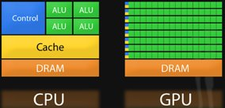
CUDA Code Constructs, Dimensions, Grids, Blocks 3/3
Software aspects,
A special kind of function called a kernel
Kernels launch a large collection of computational threads organized into groups, to be assigned to SMs
Now that we have a kernel, we 'launch' it, to 'create' a computational 'grid', composed of 'blocks' of 'threads' ( also called thread blocks )
To address each thread, each thread if provided a built-in index

Slide 44
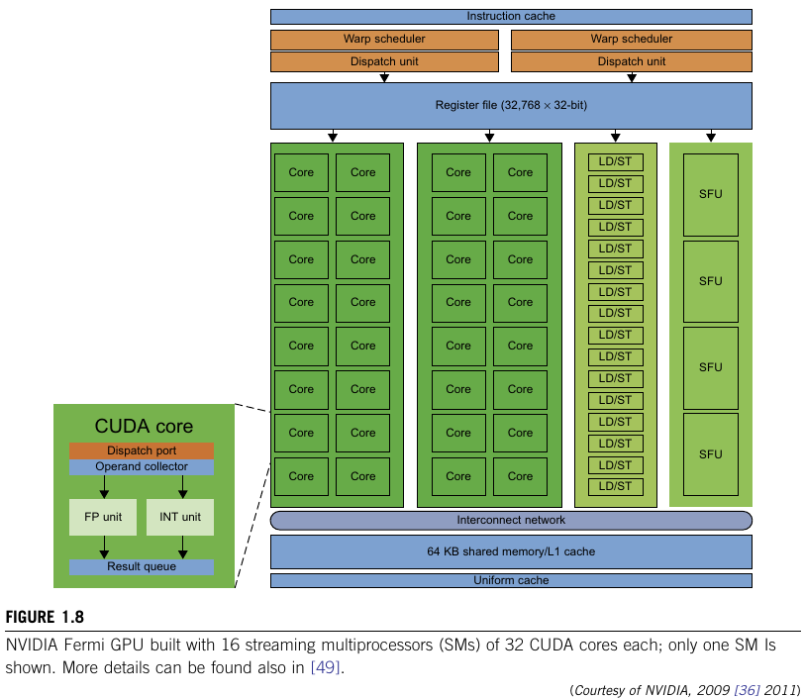
"Distributed And Cloud Computing From Parallel Processing To The Internet Of Things" Kai Hwang, et al

Slide 45
CUDA Code Constructs, Dimensions, Grids, Blocks
Notebook for the code can be found here
The <<< >>> ( chevron ) syntax
The syntax before the <<< indicates the function name, in this case, that is 'distanceKernel'
1st argument within <<< >>> indicates the number of grids we want to create, in this case, we make N/TPB grids, where N is total number of cores available, and TPB is the 'Threads Per Block'
2nd argument indicates the actual number of threads ( TPB ) passed to a grid to be assigned to a SM

Slide 46
__device__ vs __host__ 1/2
Host – refers to the CPU that instructs the GPU what the process
Device – refers to the GPU(s) attached to the CPU that take the instruction(s) and the data
Some basic qualifiers to indicate where the code will run
__global__ – this is the qualifier for kernels. These are called from the host and executed and on the device
__device__ – Functions are called from the device and execute on the device. A function that is called from a kernel needs the __device__ qualifier
Prepending __host__ __device__ causes the system to compile separate host and device versions of the function

Slide 47
__device__ vs __host__ 2/2
Kernels provide basic variables and a function declaration
Kernel functions do not have return types, so we get '__global__ void aKernel(typedArgs)'
gridDim – specifies the number of blocks in the grid
blockDim – specifies the number of threads in each block
blockIdx – to index the blocks in a grid
threadIdx – to index the thread within the block
Kernels do not have access to CPU memory
Memory is allocated separately for the device and the host, cudaMalloc(), cudaMemcpy(), cudaFree(), etc

Slide 48
From Loops To Grids
The same code emulates this example. The link again to the code can be found here
Contrasting change in where the memory is allocated to remove bottlenecks
Allocating on the 'device' instead of the 'host'
Typically, we have a plan to avoid possible overheads of memory operations via the following procedure
Copy your input data to the device once and leave it there
Launch a kernel that does a significant amount of work. The benefits of massive parallelism are significant compared to the cost of memory transfers
Copy the results back to the host only once
This is too much bookeeping, and so NVIDIA cmae up with Unified Memory, an advance topic, but it deals with GPU managed arrays. Visit here for a tutorial, a blog post from NVIDIA, 2007

Slide 49
OpenGL, Vulkan and CUDA...?
Not going into the details, but this is completely possible. If interested, you can check out
Vulkan with CUDA
OpenGL with CUDA
OpenGL code sample reference attached at the end

Slide 50
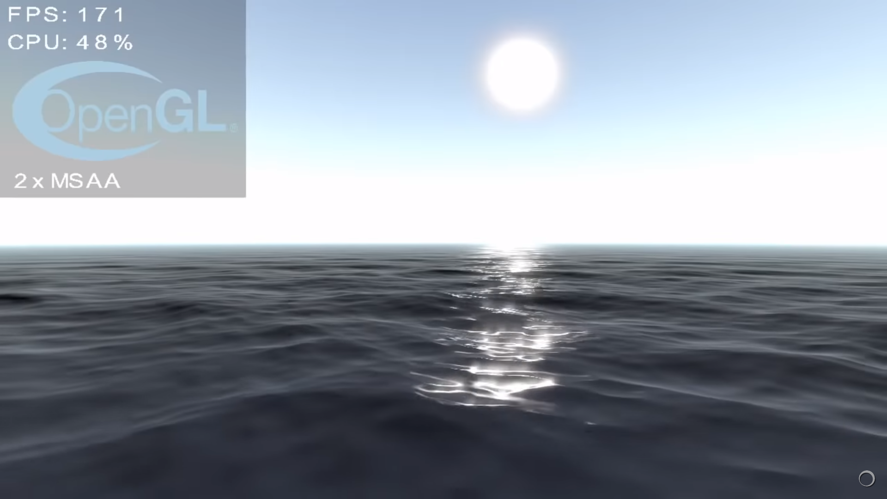
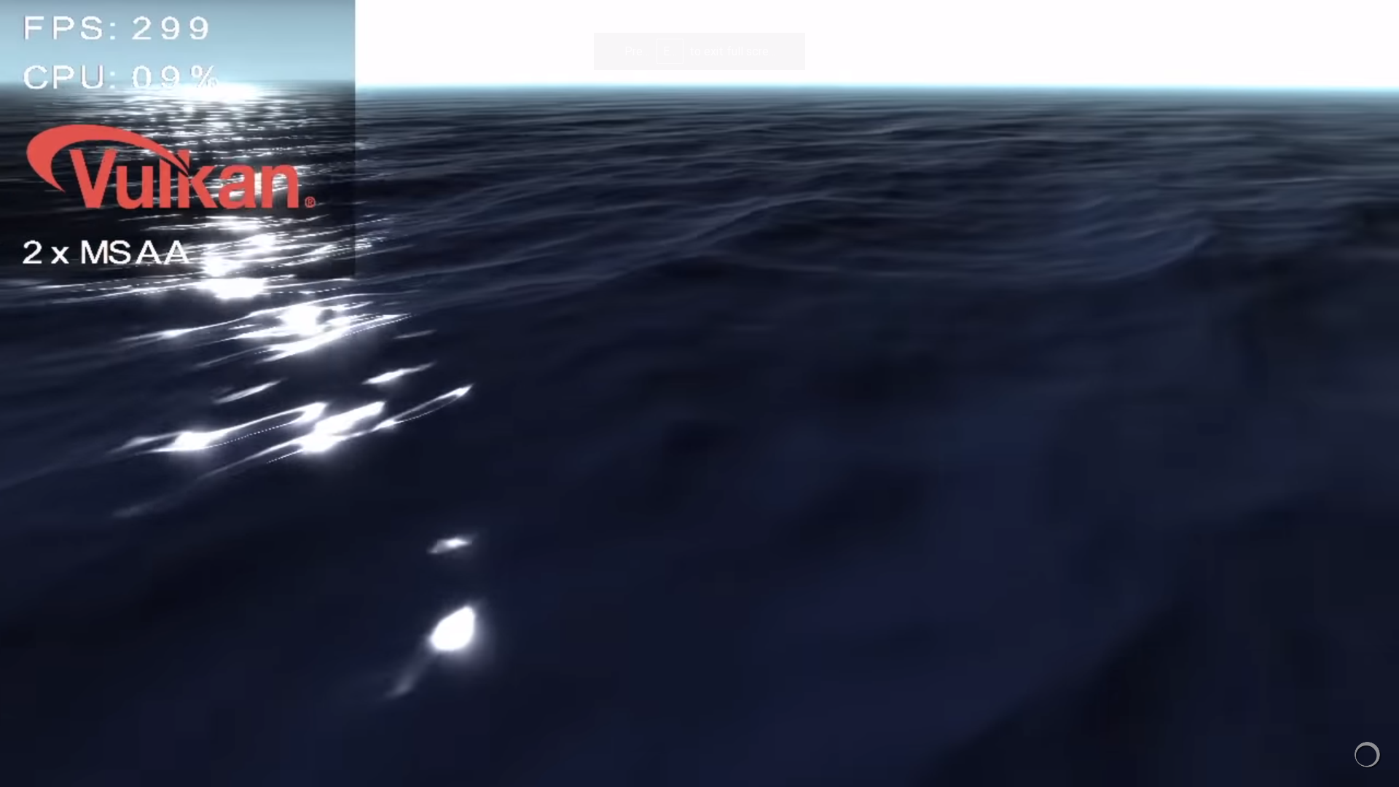
Completely possible
Vulkan adoption is slower, since it is harder to write
OpenGL is much simpler to work with, but still complex for new beginners
For reference, check out this video on YT

Slide 51
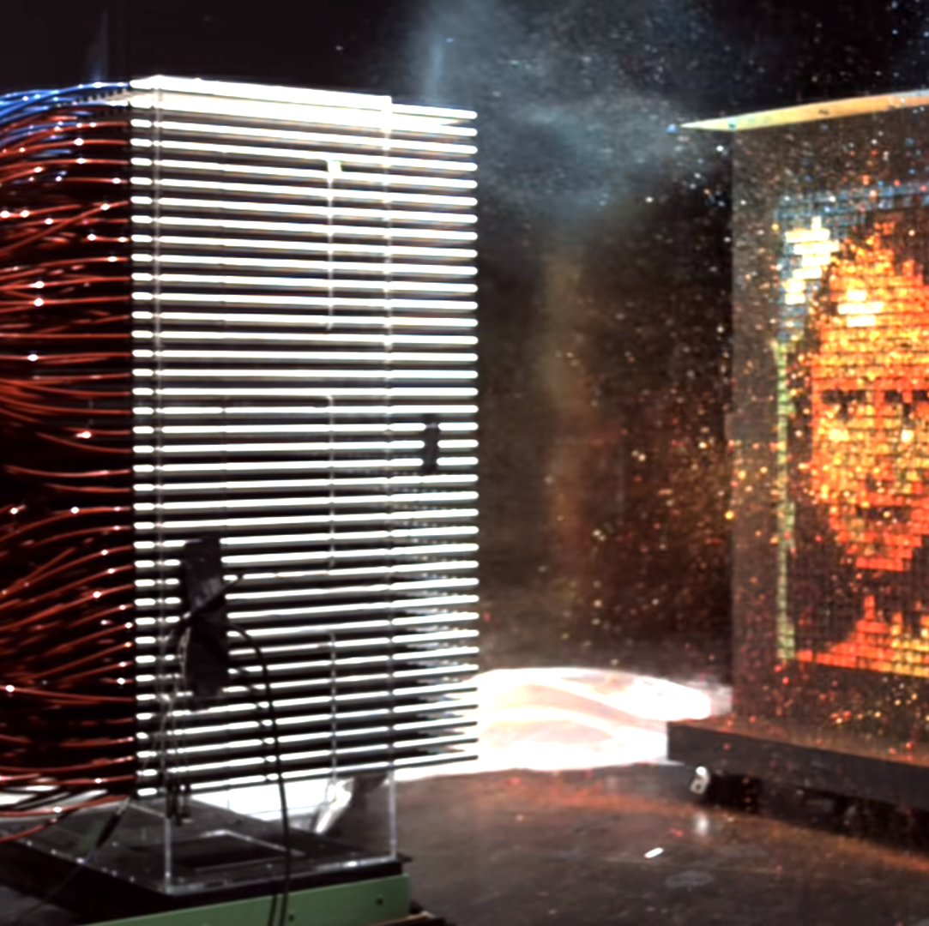
A very cool presentation by Mythbusters
Where the CPU version of a machine they use to paint Mona Lisa hits the target board one at a time
The NVIDIA GPU version shoots multiple paint balls simultaneously as needed, completing it less than 10 seconds
Check out the full presentation here on YT

Slide 52
Project Ideas!
- Look for CUDA libraries, languages, an API with features/functions that look useful and apply them to a problem of personal interest
- Go through the samples, find something that interests you, try to describe and explain it in a blog post, or an article, a brief description, and publish the writeup, share it, and ask your friends about it
- Go through the GTC talks. Find something interesting and worthwhile to work on as an exploratory project
- Visit the CUDA tag on Stack Overflow, see if there is a problem that you like to tackle
- Maybe find parallel programming books, and find problems to apply it in CUDA?
- Also, you can make an article post on Medium about the book you just read. Give it a review, discuss the presentation of ideas
- Find research papers and see if you can improve the performance of some implemented algorithms in terms of CUDA
- Explore CUDA with either OpenGL or Vulkan for graphics
- Explore the GPU Applications Catalog, see if you like to make a project similar to the ones mentioned here.
- Think about making image processing applications that implement CUDA processing under the hood to efficiently apply, for example, filters, shading, adjust vibrance, saturation, hue, tint, and other options like these
- Can you use CUDA on networking applications? If so, how?

Slide 53


Slide 54
Break! Currently summary for discussed topics. Any Q/A?

Slide 55
Last Topics, if time remains
Saved for the last few minutes. More technical details

Slide 56
Stencils And Shared Memory
Trying to emulate accessing the state of other threads involved in SIMT

Slide 57
Stencils And Shared Memory
In many applications, we have the opportunity to split the problem into multiple stages, some of which can be done independently
In SIMT parallelism, each thread has access to its own version of each kernel variable, but no access to the versions in other threads
You can try writing an array which 'hold' a possible shared state between two threads, but with hundreds, thousands, or even millions of threads, this easily gets messy
The general principle is, "the farther the data is from the processor, the longer it takes to process the data"
Shared memory aims to bridge this gap, by residing adjacent to the SM, and provides up to 48KB of storage, that can be accessed by all threads in a grid

Slide 58
Reduction And Atomic Functions
Reduction, where all the threads contribute to a single output

Slide 59
Reduction And Atomic Functions
Frequent, and very naïve examples are dot product and term-wise multiplications
Naïve approaches to solve this problem, global address memory issue
See "Reduction And Atomic Function Example" example in the notebook, here

Slide 60
Thrust Library
CUDA Toolkit Thrust is a standard C++ implementation, based on the Standard Template Library ( STL )

Slide 61
Thrust Library
Collection of scan, sort, and reduction operations, functions, and algorithms
Can be used to implement quick and easy versions of complex parallel algorithms in concise, readable source code
Good for robustness, readability, and absolute performance
Needs some familiarity with the STL C++ library to understand what templating is about and what generics are
Also included in the notebook, link again is this

Slide 62
Open Source Projects
A complete history of pretty awesome open source projects.

Slide 63
Code Samples
- https://github.com/myurtoglu/cudaforengineers
- https://github.com/NVIDIA/cuda-samples
- https://github.com/NVIDIA/CUDALibrarySamples

Slide 64
References
"CUDA For Engineers", by Mete Yurtoglu, Duane Storti. Simply this presentation and my personal learning would not have been possible without this
The awesome, awesome, NVIDA team at https://developer.nvidia.com/, this would not have been possible with out them.

Slide 65


